Slide 1
Object Oriented Software Engineering Online Books Borrow(OBB)
Students Preparation:
Feras Sameer Saleem
Mohammed Ghasan Alqunbar
Doctor:
Osama Qtaish

Slide 2
Define and describe the problem
The problem of borrowing books: It is a problem related to borrowing a book from the library. The required book may not be available in the library, or it may be loaned to someone else, which leads to wasting time in going to the library and searching for the book while it is not available.

Slide 3
Solve the problem
creating a software for borrowing books online through which you can search, select and book a book before going to the library

Slide 4
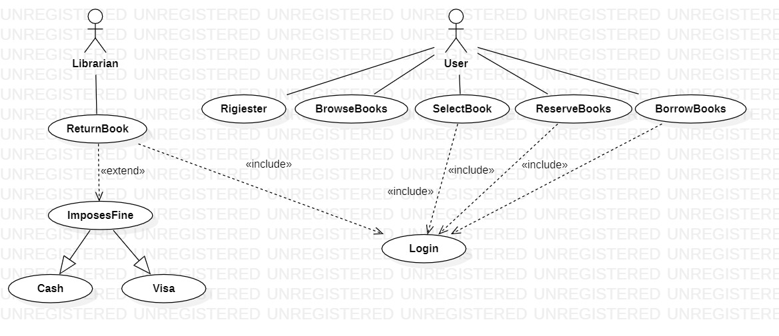
Use-Case Modeling
project of Online Books Borrow(OBB), It is a book borrowing management system.

Slide 5
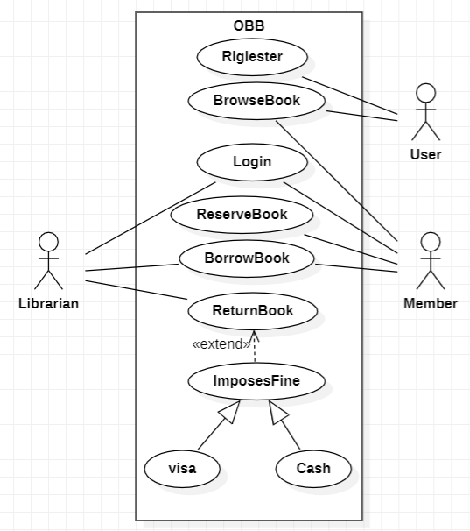
Use-Case Modeling
project of Online Books Borrow(OBB), It is a book borrowing management system.

Slide 6
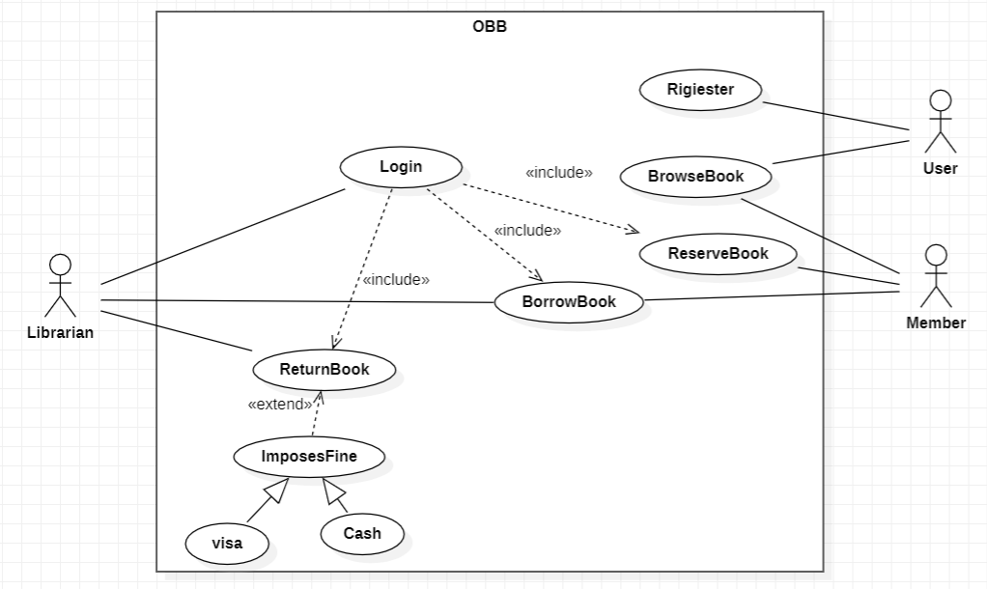
Use-Case Modeling
project of Online Books Borrow(OBB), It is a book borrowing management system.

Slide 7
Use-Case Description
BorrowBooks | Use case name
Librarian, Member | Participating actors
The Librarian is logged into OBB | Entry condition
The librarian opens the web page The librarian login on the web page The member approaches the librarian with the book they wish to borrow. The librarian checks the availability of the book in the library's stock. If the book is available: a. The librarian records the loan by associating the book with the member. b. The librarian issues the book to the member. The loan period starts from the current date for a maximum period of two weeks | Flow of events
Member take a Book | Exit condition
Return the book at the time of delivery | Quality requirements

Slide 8
Use-Case Description
ReserveBooks | Use case name
Member | Participating actors
The Member is logged into OBB | Entry condition
Open the web page Browse available books Login Click on the selected book Click on the Reserve button | Flow of events
Send notice of book information | Exit condition
Choose the right book and Reserve it | Quality requirements

Slide 9
Login | Use case name
Member, Librarian | Participating actors
Open the Web Site | Entry condition
Member Open the Web Site Member login to OBB Member Write a username Member Write a password The system checks if the username and password are correct If correct, log in If wrong, a notification is sent to re-type the name or password2. Librarian Open the Web Site Librarian Open the Web Site Librarian login to OBB Librarian Write a username Librarian Write a password The system checks if the username and password are correct If correct, log in If wrong, a notification is sent to re-type the name or password2. Librarian Open the Web Site | Flow of events
Logged in OBB | Exit condition
Facilitate the borrowing process Find the required books without wasting time | Quality requirements

Slide 10
Use-Case Description
Use case name
ImposesFine
Participating actors
Librarian
Entry condition
The Librarian is logged into OBB
Flow of events
The User was late in delivering the book
Impose a fine on the User
Send a notice of the fine amount
Exit condition
Send a notice of the fine amount
Quality requirements
Receive books without delay

Slide 11
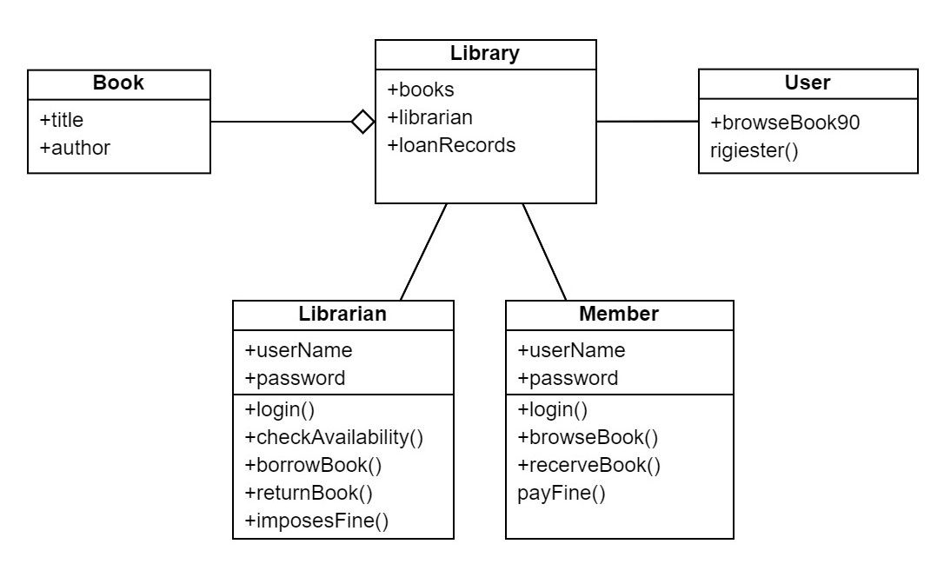
Class Diagrams

Slide 12
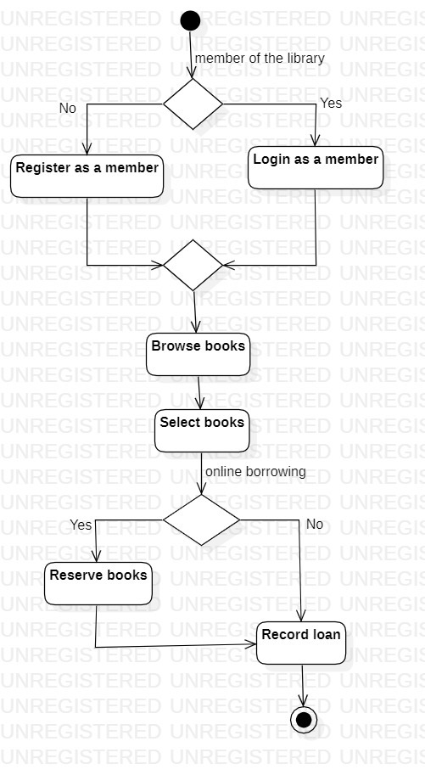
Activity Diagrams

Slide 13
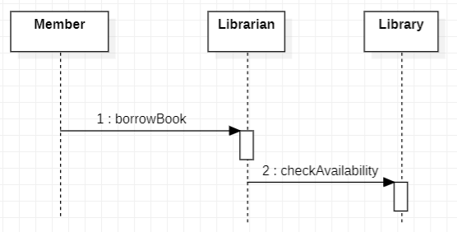
Sequence Diagrams

Slide 14
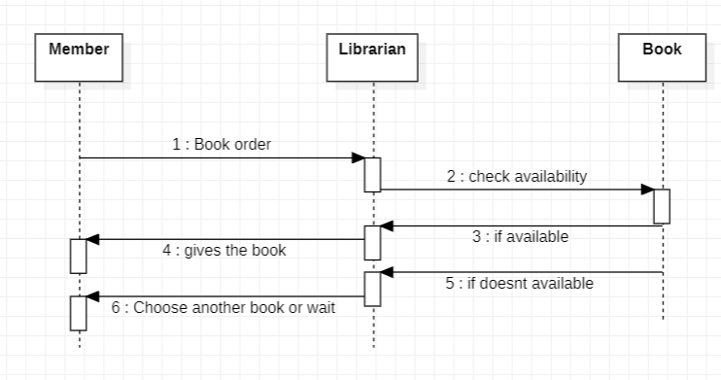
Sequence Diagrams

